Slide 1
Claude the SAS Programmer
Agentic AI creates SAS 9 code before your eyes

Slide 2


Github Link for Powerpoint + Code
Joe Matise
Supervisor, Data Engineering, NORC

Slide 3


Agenda
1
Introduction – What is Agentic AI?
2
Using Agentic AI with SAS: Tools Required
3
Let’s Code!
4
Prompt Engineering: Programming the Programmer
5
Conclusion

Slide 4
About this presentation
This presentation is targeted to SAS 9.4, not SAS Viya. See the sessions about SAS Viya MCP for more information there!
Most of what I present here applies to any Agentic AI solution, but Claude Code and Github Copilot are the solution I tested this with and use for the examples.
As with any AI solution – use this with caution and skepticism of the results. Read the documentation for your chosen solution how to protect yourself from the Agentic AI doing dangerous things.

Slide 5
What is Agentic AI?

Slide 6
What is Agentic AI?
Agentic AI can independently break down complex tasks, use tools, and iterate on solutions with minimal human intervention. (Claude Sonnet 4.5)
The ability to run code independently and verify the results is a key differentiator for Agentic AI
In order for Agentic AI to function at its full potential, there must be a connection between the AI and SAS.

Slide 7


Examples of Agentic AI
Claude Code
Github Copilot
Codex

Slide 8
Why use Agentic AI?
Agentic AI does not replace the programmer – it changes the relationship with the code.
Agentic AI is a tool that can increase productivity when used properly
Guiding the AI to produce code that gives good results is not an easy task!
When used with good tests and well-developed prompts, Agentic AI can reduce the time to deliver results significantly.
Also strongly consider this for data exploration – similar to how Visual Analytics is often used.

Slide 9
Tools for using Agentic AI

Slide 10
Tools for using Agentic AI
Requirements
Interface
How do you interact with the Agentic AI?
The Agentic AI solution
This depends on your interface
Follow the interface-specific configuration steps
Method of connecting to SAS
How does the Agentic AI submit SAS code?
How does the Agentic AI read the results of the SAS code?

Slide 11
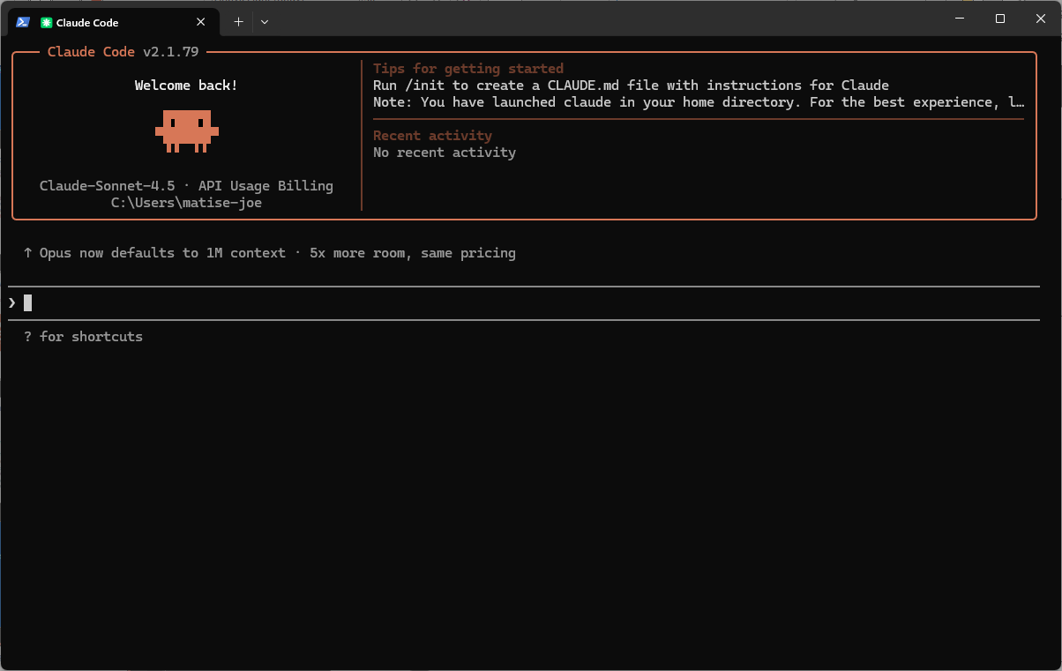
Tools for using Agentic AI
Interface Options
Options for Agentic AI
Standalone (command line/terminal)
Component to IDE like VS Code
Chat-like interface
Recommendation: VS Code Extension
https://code.visualstudio.com/
https://code.claude.com/docs/en/vs-code
Notes:
Next slide – show it writing code

Slide 12
Let’s Code!
Live demos with AI never go wrong…

Slide 13
The Data Source
https://gss.norc.org/get-the-data.html
General Social Survey – 50+ years of data of Americans’ habits, demographics, and more

Slide 14
The Prompt
Using data from https://gss.norc.org/get-the-data.html , please analyze the differences between [something] in 2022 and 2024. Compare across gender and age groups separately and together.
Produce an excel file with the outputs of the analysis. The excel file should have different tabs for each grouping (age, gender, age*gender) and also separate tabs for graphical comparisons.
Aim for a general public level of analysis. Include a readme that explains the file.
Use ODS Graphics to produce charts that illustrate the comparisons. Use the color palette and style from https://gss.norc.org/ .

Slide 15
Tools for using SAS with Agentic AI

Slide 16
Tools for using Agentic AI with SAS
Backend Options for submitting SAS Code
Options for submitting SAS code
Direct SAS connection via batch submission at the command line
SASPy – via Python
SAS Viya has API options available as well
Recommendation: SASPy; most flexible and best parsing of results.

Slide 17
Tools for using Agentic AI
SASPy
SASPy is an open source Python package that allows Python coders to access SAS data and analytics capabilities. Add SASPy to your Python environment, configure it to connect to your SAS environment, and begin using Python to access SAS.
https://support.sas.com/en/software/saspy.html
https://github.com/sassoftware/saspy/releases

Slide 18
Tools for using Agentic AI
Configuring SASPy for SAS Server connections
Option 1: SSH - https://sassoftware.github.io/saspy/configuration.html#ssh
This is the common terminal connection, which allows SSH-based connectivity and works with both Linux and Windows servers. Works best with simple configurations.
Option 2: IOM - https://sassoftware.github.io/saspy/configuration.html#iom
This is useful for more complex configurations, including Grid.
Requires Java
Option 3: COM – https://sassoftware.github.io/saspy/configuration.html#com
This only works for Windows clients, but avoids using Java!
For all options, determine how you will connect – type in password interactively, use .authinfo/_authinfo, or other options.
Notes:
Table of options/etc on a next slide

Slide 19
Tools for using Agentic AI
SASPy Connection Wrapper
https://github.com/matise-joe-norc/connect-saspy/
Useful Python code for helping the Agentic AI easily connect to SASPy
Allows submitting code with a single Python method call (after connection is established)
Contains many comments that will improve the ability of Agentic AI to utilize the class

Slide 20
connect_saspy.py
The wrapper that makes it work
Methods:
_start_connection(): internal method to initiate the SASPy connection
_test_connection(): internal method to validate the SASPy connection
submit(code): Submits SAS code (as text) to SASPy. Starts a connection if none exists.
close_connection(): Closes the SASPy connection
Automatically initiates a connection to SASPy – no action needed by the AI!

Slide 21
SASPy Best Practices
Use an SSH Key or Authinfo file so the connection is automatic with no user intervention needed
Keep the connect_saspy.py and example_usage.py in the folder you are working with, or in a related folder in the context window
Make sure saspy is in your requirements.txt file
Test using connect_saspy yourself before using it with the AI

Slide 22

Tools for using Agentic AI
sas-mcp Model Context Protocol
https://github.com/matise-joe-norc/sas-mcp
MCP that enables Agents to connect to SAS via a tool
Uses SASpy backend
Contains specific methods for common actions
Limits agents by default to WORK to avoid dangerous writes
Install via `pip install sas-mcp` or `uv tool install sas-mcp`
MCP will automatically set up authinfo and saspy configuration through a wizard (`sas-mcp init`)

Slide 23
Tools for using Agentic AI
MCP, Skill, Prompt – what is the difference?
MCP
System-wide
Automatically used; does not modify prompt
Skill
System-wide
Soft limits
Prompt
Task-specific
Contains what you need for the specific task you are doing
Helps agent build better prompts
Tool for connecting with hard limits
Guide for agent to use when doing specific tasks
Prompt then leads agent to use skills or tools
Can encourage agent to use MCP tool
Similar to an API – not a prompt/AI itself

Slide 24
Prompt Engineering Tips
Programming the (AI) Programmer…

Slide 25
Skills – Helping the agent
Skills are small files that help the agent do specific tasks
Skills can tell the agent to follow style guidelines, show it how to write certain kinds of programs, help it properly use tools, and more
Skills should be fairly short, and focused on a particular kind of task – agents having to read long skills will consume more tokens
Best practice: build a skill *after* doing a task with an agent one or more times
Include what corrections you made, what things worked well, and what context was provided
Consider asking the agent to create a skill after a successful session!
Limit text in the skill to just what is needed – don’t include things the agent already knows
https://agentskills.io includes specifications and tips!

Slide 26
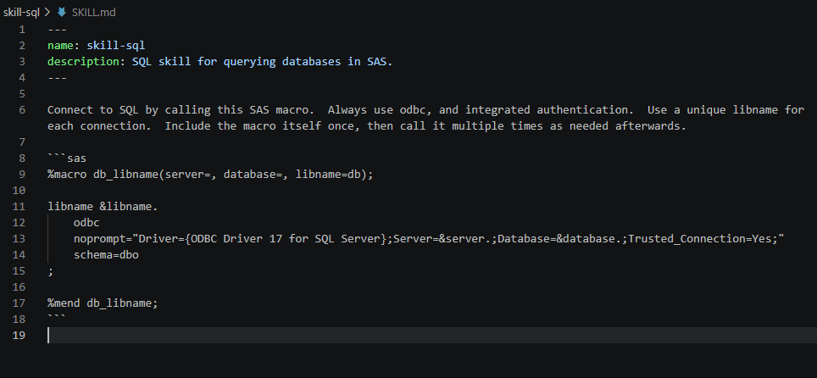
Skill Example

Slide 27
Requirements-driven development
For larger projects, this can be a powerful method of developing!
Requirements file describes the data, the request, and the format of the results
Improves consistency of outputs
Traceability: you can see what was asked
Efficiency: you can agree on what is needed
Verification: you can confirm what is done
Agent can update requirements for you
Later changes in ‘feature_1.md’ ‘feature_2.md’ etc

Slide 28
Example of Requirements.txt
---
Requirements
name: gss-example
description: Analyzing [something] in the GSS data across the years 2022-2024 for WUSS audience
---
# Data
Data source: https://gss.norc.org/get-the-data.html
Pull data for 2022 and 2024 years. Filter to the variables related to age, gender, respondent ID, and [something], plus the weights.
# Analysis
Analyze [something] between years 2022 and 2024, at the overall level as well as at the age, gender, and age*gender crosses. Use weights in the analysis, in PROC SURVEYFREQ or PROC SURVEYMEANS.
# Report
Produce an excel file with the outputs of the analysis. The excel file should have different tabs for each grouping (age, gender, age*gender) and also separate tabs for graphical comparisons.
Aim for a general public level of analysis. Include a readme that explains the file.
Use ODS Graphics to produce charts that illustrate the comparisons. Use the color palette and style from https://gss.norc.org/ .

Slide 29
Other Prompt Best Practices
Treat the agent like a junior programmer – give really specific detailed instructions
High information density is good – but keep it readable so future-you can understand
Include what to avoid and what to require
Identifying comparable programs or processes can save time
Even if you don’t use a requirements style organizational structure, writing longer prompts in text files can simplify things and avoid lost time

Slide 30
Questions?

Slide 31
Thank you!

